Slide 1
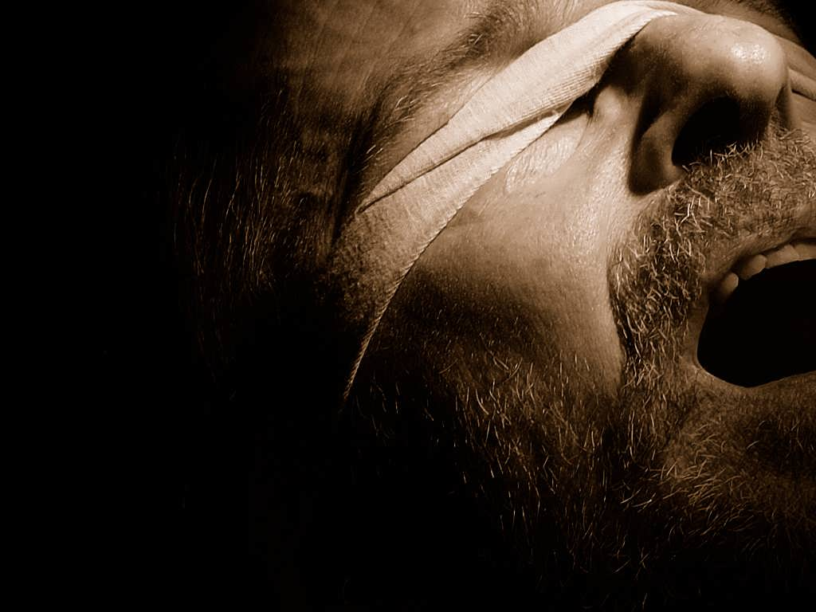




the bondage of
Cults and Isms
the Watchtower
A free CD of this message will be available following the service
It will also be available for podcast later this week at calvaryokc.com

Slide 2
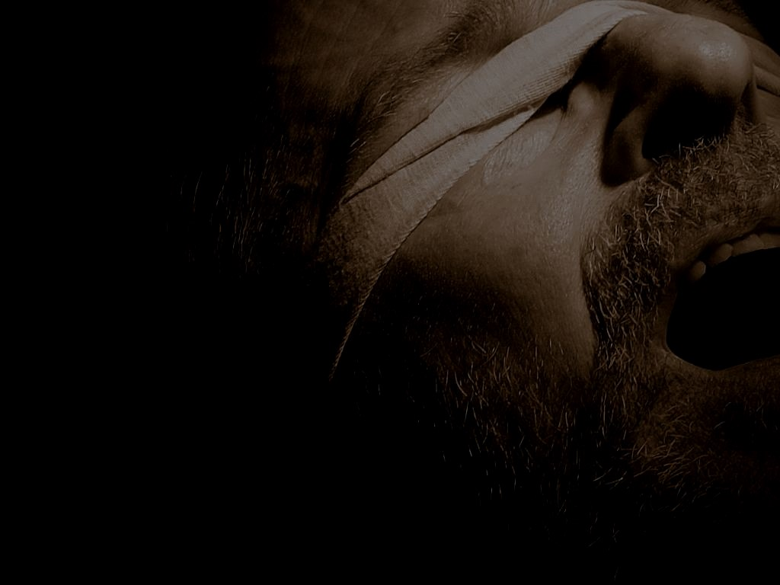
Charles Russell
1879-1917
Nathan Knorr
1942-1977
Milton Henschel
1992-2000
1870
1890
1910
1930
1950
1970
1990
2010
Joseph Rutherford
1917-1942
Frederick Franz
1977-1992
Don A. Adams
2000-present
the bondage of the Watchtower

Slide 3
Watchtower Growth Chart
21,000,000
18,000,000
Memorial Attendance
15,000,000
Active “Publishers”
12,000,000
9,000,000
6,000,000
3,000,000
1920
1930
1940
1950
1960
1970
1980
1990
2000
2010
the bondage of the Watchtower

Slide 4
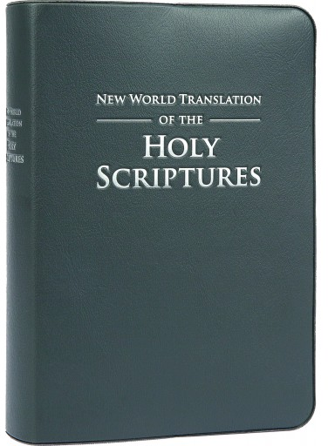
New Testament released in 1950, entire Bible completed in 1961
208,000,000 copies in 122 languages
Walter Martin ~ “The New World Bible translation committee had no known translators with recognized degrees in Greek or Hebrew exegesis or translation... None of these men had any university education except Franz, who left school after two years, never completing even an undergraduate degree."
the bondage of the Watchtower

Slide 5


Awake!
Watchtower
the bondage of the Watchtower

Slide 6
Watchtower, Jan. 15, 1969, pg. 51 ~ “Jesus foretold that among his people there would be a ‘faithful and discreet slave’ class who would be providing the spiritual food of God’s family of devoted servants on earth, acting as his channel of communication and overseeing the carrying out of the Kingdom interests worldwide.” (Matt. 24:45-47)
the bondage of the Watchtower

Slide 7
Watchtower, Oct. 1, 1994, pg. 8 ~ “All who want to understand the Bible should appreciate that the ‘greatly diversified wisdom of God’ can become known only through Jehovah's channel of communication, the faithful and discreet slave."
the bondage of the Watchtower

Slide 8
Watchtower, Oct. 1, 1967, pg. 587 ~ “Thus the Bible is an organizational book and belongs to the Christian congregation as an organization, not to individuals, regardless of how sincerely they may believe that they can interpret the Bible."
the bondage of the Watchtower

Slide 9
Watchtower, Aug. 15, 1981, pg. 29 ~ “From time to time, there have arisen from among the ranks of Jehovah's people those who, like the original Satan, have adopted an independent, faultfinding attitude . . . They say that it is sufficient to read the Bible exclusively, either alone or in small groups at home.
the bondage of the Watchtower

Slide 10
Watchtower, Aug. 15, 1981, pg. 29 ~ But, strangely, through such ‘Bible reading,' they have reverted right back to the apostate doctrines that commentaries by Christendom's clergy were teaching 100 years ago..."
the bondage of the Watchtower

Slide 11
A non-prophet organization
1874 ~ Christ returned
1914 ~ Christ returned (official teaching today)
1914 ~ End of the world (“gospel age”)
1925 ~ Return of Abraham, Isaac, Jacob and David
1940 ~ Great Tribulation has begun
the bondage of the Watchtower

Slide 12
A non-prophet organization
1940 ~ Nazis and Fascists would defeat Great Britain
1975 ~ end of “6,000 years of man’s history”
the bondage of the Watchtower

Slide 13
Beliefs
All present day religions are “Babylon the Great” (Rev. 17)
Forbid blood transfusions
No Pledge of Allegiance, birthdays or holidays
Salvation through faith and obedience to the Bible
No literal hell
the bondage of the Watchtower

Slide 14
Beliefs
Only 144,000 (“little flock”) go to heaven
The “holy spirit” is an impersonal force
Jesus did not die on the Cross, but rather a “torture stake” (stauros)
the bondage of the Watchtower

Slide 15
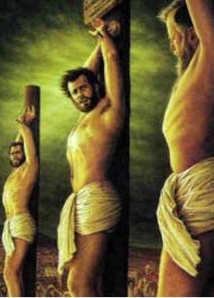
John 20.25 ~ So he said to them, “Unless I see in His hands the print of the nails, and put my finger into the print of the nails, and put my hand into His side, I will not believe."
From “Knowledge That Leads to Everlasting Life”
the bondage of the Watchtower

Slide 16
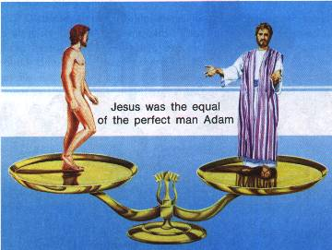
You Can Live Forever in Paradise on Earth, pg. 63
the bondage of the Watchtower

Slide 17
The boy threw a ball
Subject
Verb
Object (Predicate)
the bondage of the Watchtower

Slide 18
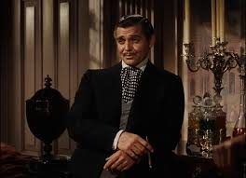
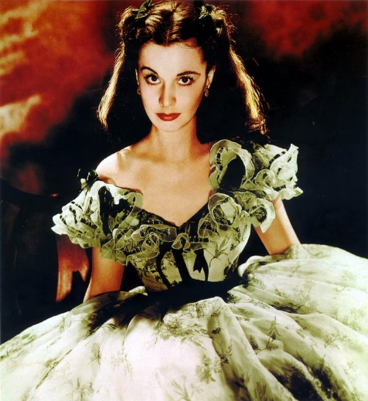
Scarlett O’Hara loves Rhett Butler
Rhett Butler loves Scarlett O’Hara
the bondage of the Watchtower

Slide 19
“the” = ho
“a” or “an” = ______
If the definite artcle is absent, an indefinite article is implied
John 1.1 (NWT) ~ In [the] beginning the Word was, and the Word was with God, and the Word was a god.
the bondage of the Watchtower

Slide 20
“Colwell’s Rule” (John 1.1)
“Definite predicate nouns which precede the verb usually lack the article . . . a predicate nominative which precedes the verb cannot be translated as an indefinite or a ‘qualitative’ noun solely because of the absence of the article; if the context suggests that the predicate is definite, it should be translated as a definite noun.”
the bondage of the Watchtower

Slide 21
“Colwell’s Rule” (John 1.1)
In the beginning was the Word, and the Word was with God, and the Word was God.
En archē ēn ho Logos kai ho Logos ēn
In beginning was the Word and the Word was
pros ho Theos kai Theos ēn ho Logos
toward the God and God was the Word
the bondage of the Watchtower

Slide 22
“Colwell’s Rule” (John 1.1)
John 1.18 (NWT) ~ No man has seen God at any time; the only-begotten god who is at the Father’s side is the one who has explained Him
No definite article
Definite article ho
John 20.28 (NWT) ~ In answer Thomas said to him: “My Lord and my God!”
the bondage of the Watchtower

Slide 23
“Sharp’s Rule” (Tit.2.13)
“When two nouns of the same case are connected by kai (and), and the definite article appears before the first noun but not before the second, both nouns refer to the same person.”
Tit. 2:13 ~ looking for the blessed hope and glorious appearing of our great God and Savior Jesus Christ,
of our great God and Savior Jesus Christ
tou megalou Theou kai sōtēros hēmōn Iēsou Christou
Definite article
the bondage of the Watchtower

Slide 24
“Sharp’s Rule” (Tit.2.13)
The boy he threw the ball
Literally, the great God of us and the Savior of us, Jesus Christ
the bondage of the Watchtower

Slide 25
Is. 43:10-11 ~ ¹⁰ “You are My witnesses," says the Lord,
“And My servant whom I have chosen,
That you may know and believe Me,
And understand that I am He.
Before Me there was no God formed,
Nor shall there be after Me.
¹¹ “I, even I, am the Lord,
And besides Me there is no savior.”
the bondage of the Watchtower

Slide 26
1 + 1 + 1 = 3
Father
1 x 1 x 1 = 1
is
is not
is not
God
is
is
Son
Spirit
is not
the bondage of the Watchtower

Slide 27
the bondage of the Watchtower

Slide 28
$7.00
$4.25
the bondage of the Watchtower

